Slide 1
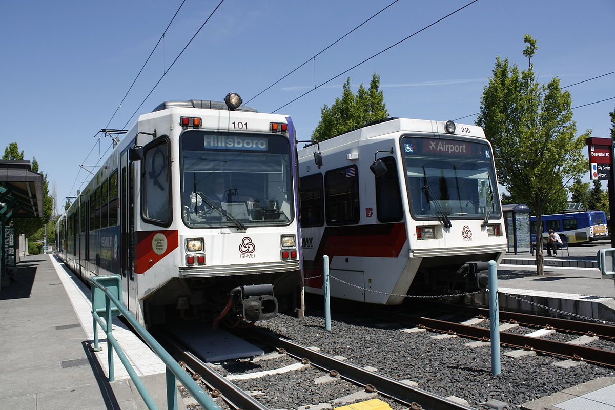

TriMet System Knowledge and Trip Planning Tools

Slide 2
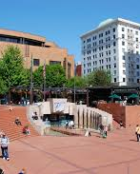
TriMet Customer Service: 503-238-RIDE (7433)
  Hours of service: Daily, 7:30 am-5:30 pm
  Pioneer Square: 701 SW 6th Ave, Portland
TriMet Website: TriMet.org
System Maps and Schedules for Buses, MAX and Streetcar
Transit Tracker: Text stop ID # to 27299
Call 503-238-7433, Option 1-Transit Tracker
Option #3- Live trip planning assistance.

Slide 3
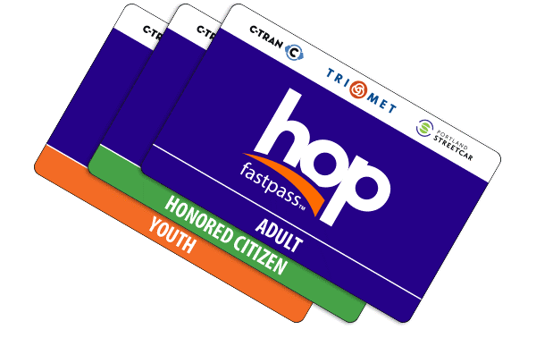
Hop Fastpass:
myhopcard.com
Single use tickets
Use exact cash
Fare: No Free Rides
 | 2 ½ hours | All-day Pass
Student | $1.25 | $2.50
Honored Citizen | $1.25 | $2.50
Adult | $2.50 | $5.00

Slide 4
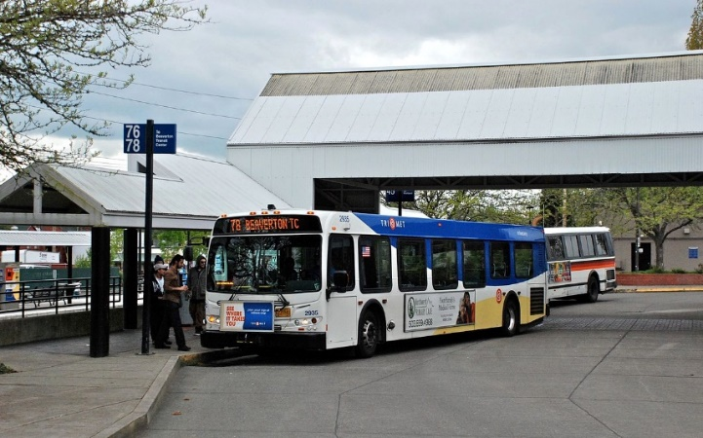
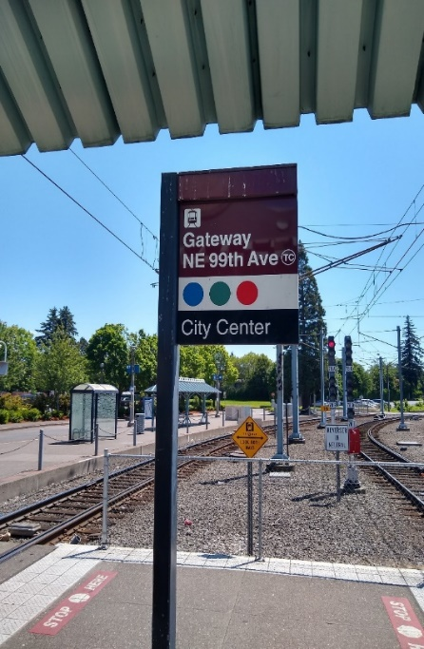
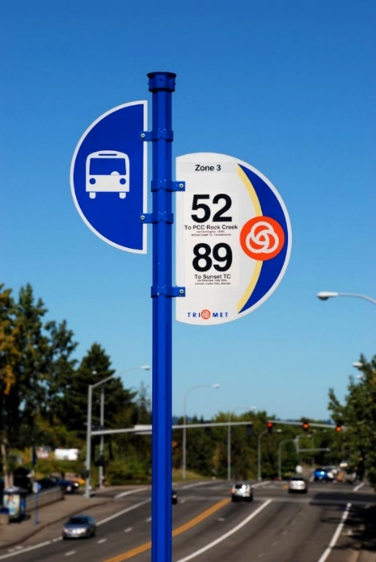
Transit Stops
TriMet bus stops have certain information at the stop:
Bus route number
Direction it is going
Stop ID number
Symbol for type of transit vehicle
Color of MAX line and the destination

Slide 5
Transit Centers
A Transit Center (TC) is a major transit hub served by several bus and/or rail lines.
TriMet transit centers are conveniently located throughout the metro area.

Slide 6
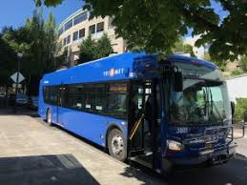
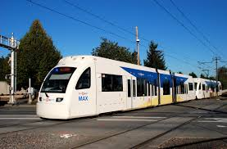
The Portland Transit Mall
The Portland Transit Mall is Downtown Portland’s transit hub, spanning more than 57 blocks along 5th and 6th avenues.

Slide 7
Park & Ride Locations
Whether you are meeting your carpool or catching the bus, MAX or WES, you can park free of charge up to 24 hours (unless otherwise posted) at these Park & Ride locations.
Overnight parking is permitted, as long as your stay does not exceed 24 hours. Always lock your vehicle and do not leave valuables inside.

Slide 8
Rules for Riding... "Respect the Ride"
Valid and correct fare is required.
Move for seniors and people with disabilities.
Don't threaten or intimidate riders or operators.
Don't be so loud that you disturb others.
Don't block the aisles or doors.
If you bring a pet, keep it in a carrier.
Keep food and drinks in closed containers.

Slide 9
The TriMet service area currently encompasses an area of about 533 square miles. The TriMet district serves portions of the counties of Multnomah, Washington, and Clackamas; it extends from Troutdale to Forest Grove east to west, and from Sauvie Island to Oregon City and Estacada north to south.

Slide 10
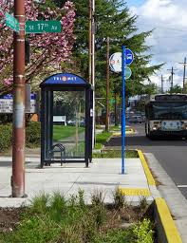
Fixed-Route Bus System
85+ bus line routes.
More than 6,600 bus stops.
Shelters only at stops with an average of at least 50 weekday boarding rides.
Other upgrades can include benches, protected crossings and improved waiting areas.
Transit routes run on a certain route and schedule.

Slide 11
MAX Light-Rail System
Five MAX Light-Rail Lines:
Blue
Red
Yellow
Green
Orange

Slide 12
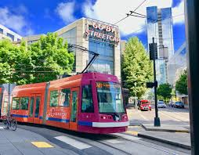
Portland Streetcar
Three Lines of Service:
NS Line, Loop A, Loop B

Slide 13
Safety
Transit Police and Security Personnel
Fare Inspection
Security Cameras
Station Design
Rules & Penalties
Fact: Most crimes reported on bus, MAX and WES are minor incidents and property crimes, such as vandalism. There are fewer than two reported incidents a day, which is about one in every 231,000 rides.

Slide 14
TriMet Trip Planner
http://www.trimet.org/

Slide 15



Applications (“apps”) can help you plan a trip on the go, in real time, and track your location along your trip. You can get these apps at these sites:

Slide 16
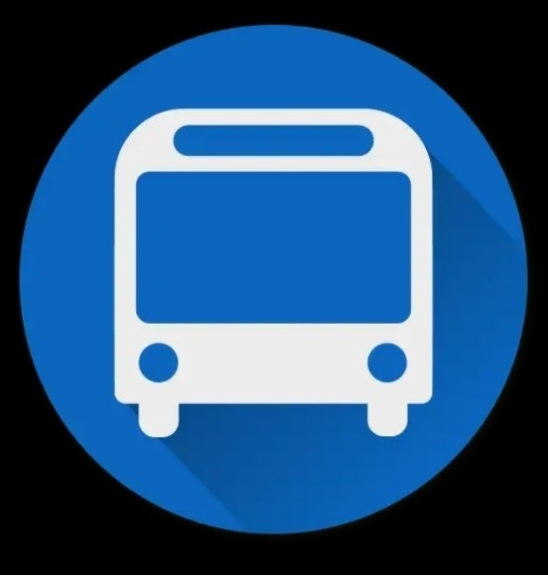
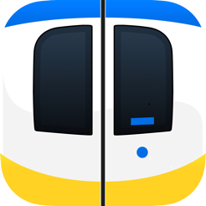


Transit Tracker
Moovit
Moovel
PDX Bus
(iPhone only)
Google Maps
Transit
Hop Fastpass
All these apps are free

Slide 17
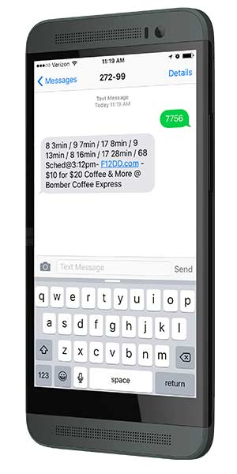
Transit Tracker-Text
Text your Stop ID Number to 27299

